Slide 1
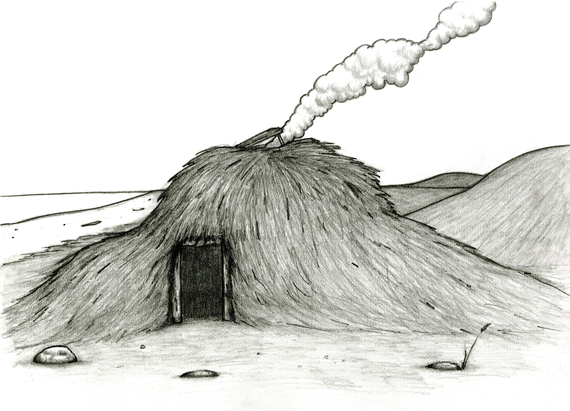
Mal’uk nukallpiak etaa______ ciqlluami kigpiarmek.

Slide 2
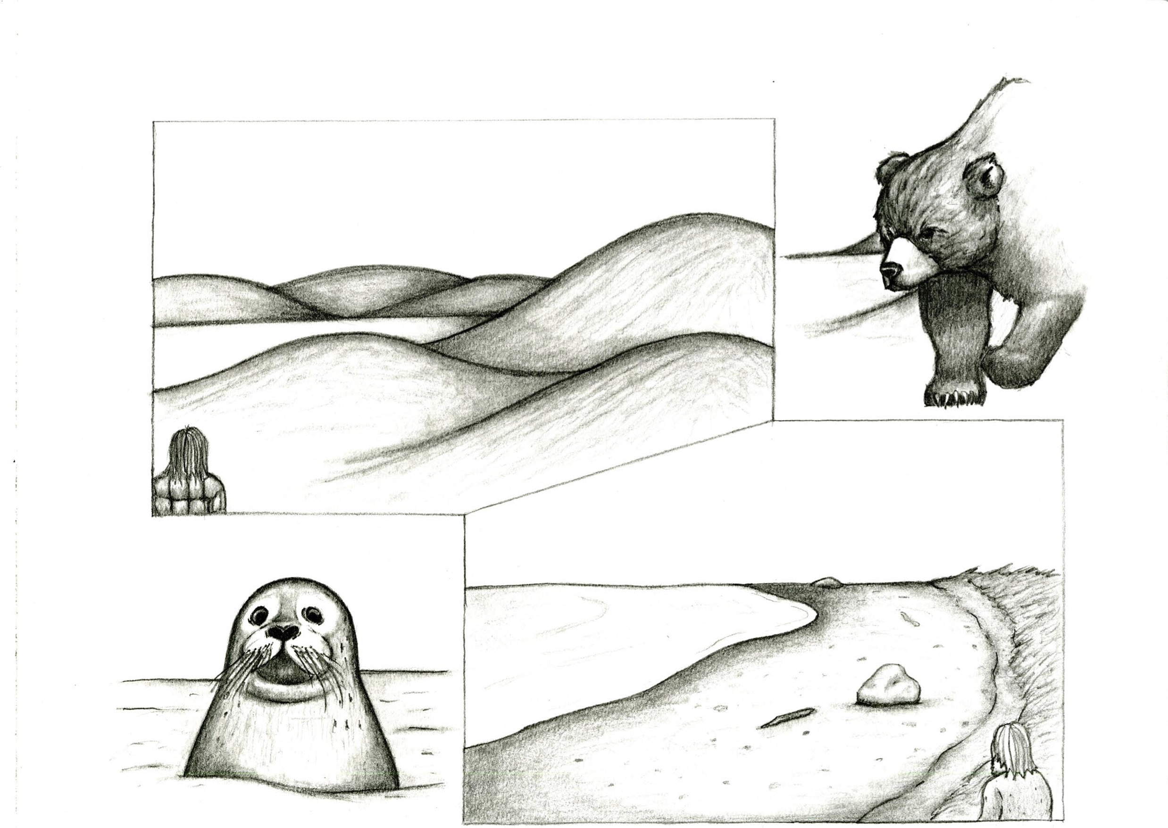
Sunarausqaq, tang’rhnisqaq pisurtaa_____ ingritni taquka’anek.Angutguaq cucunaitsqaq pisurtaa______ imarmi isuwiinek.

Slide 3
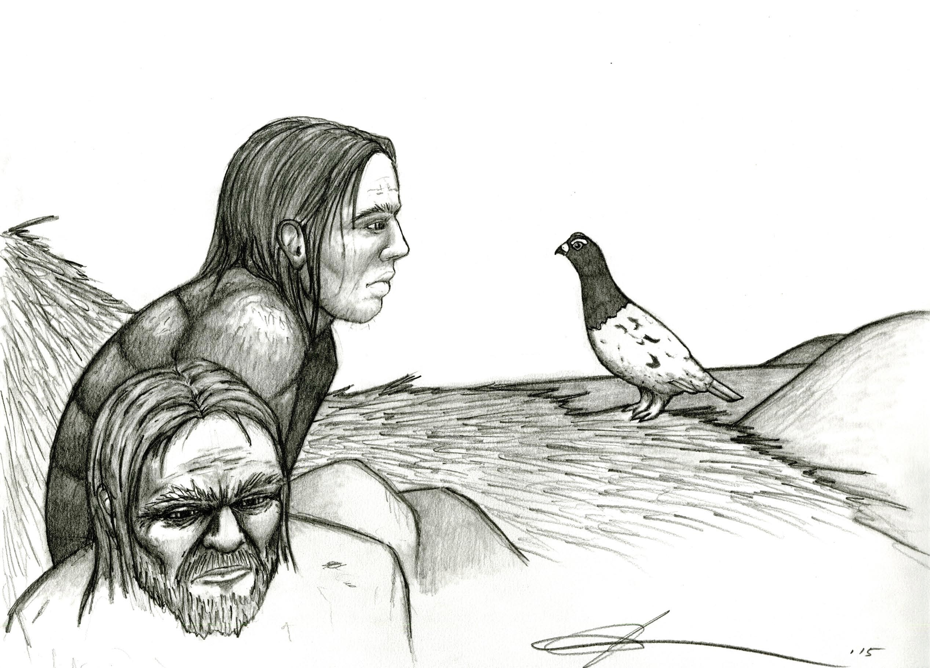
Nukallpiak angitaa_____ pisuryangamek. Taumi-llu Qateryuk mit____ Tang’rnisqam canyanun.

Slide 4
Tang’rnisqam pingaknillki Qateryuk. Mal’ugnek cingki, kayarualuku, “Awa maken, qa’i-cali taiyuten maut?” Pinga’iwagni, angq’rqiars’ki Qateryuk.

Slide 5
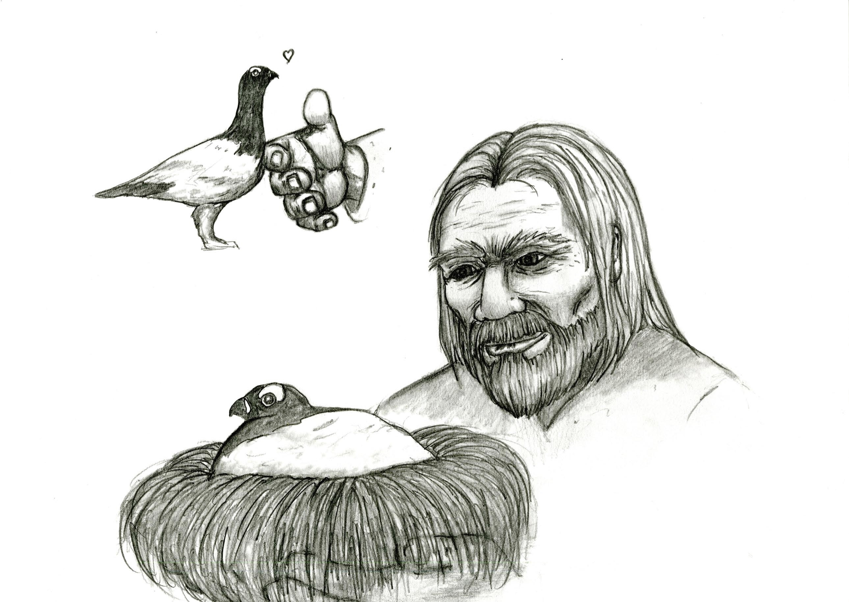
Taumi-llu Qateryuk age_______ angutguamen. Angutguaq ugau_______, pingaklluku. Ataku, angutguaq nertali______ taumi neregkwarluku Qateryuk.

Slide 6
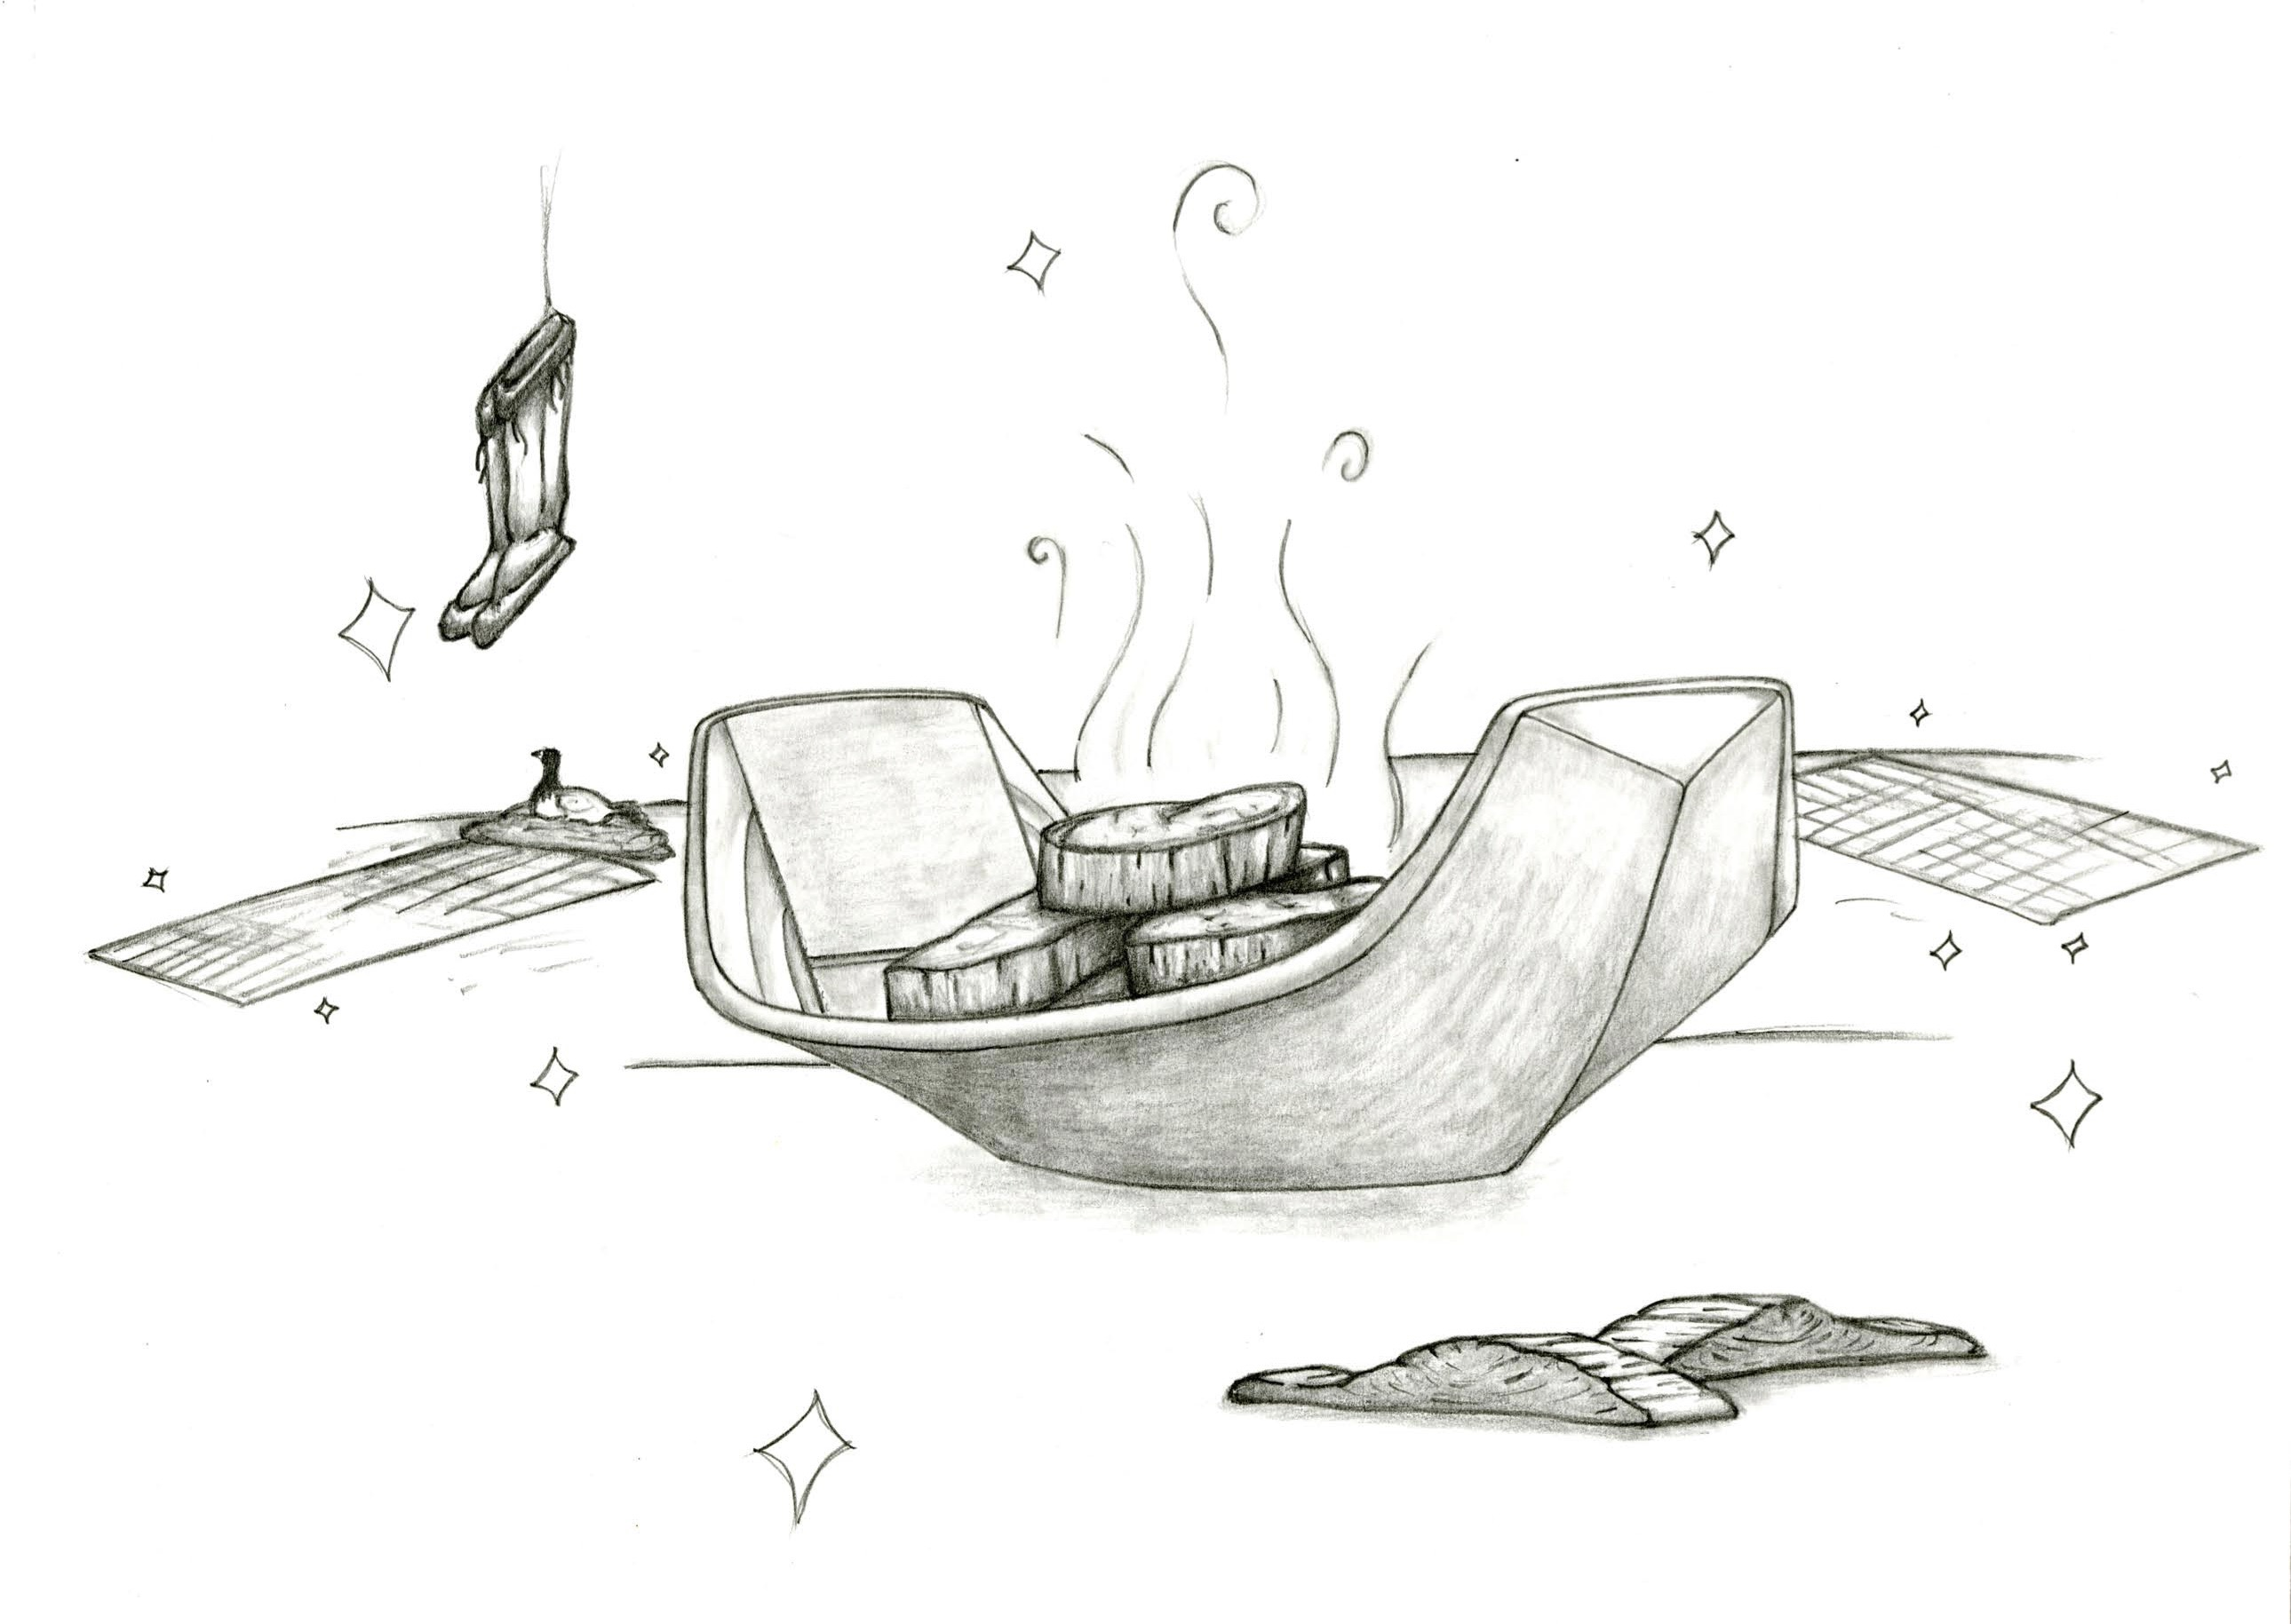
Ertii tamiin (2) pisuryar________, angitllutek ciqlluamen. Ciqlluaq epritengia’ar_________, neq’rkanek kenimaluni, cali pikiyutaq nutaasqaq elluni angutguam engluani. Nukallpiak nallulutek kinam ciqlluaq asirca’iki, kenirluni, pikiyutaliluni cali.

Slide 7
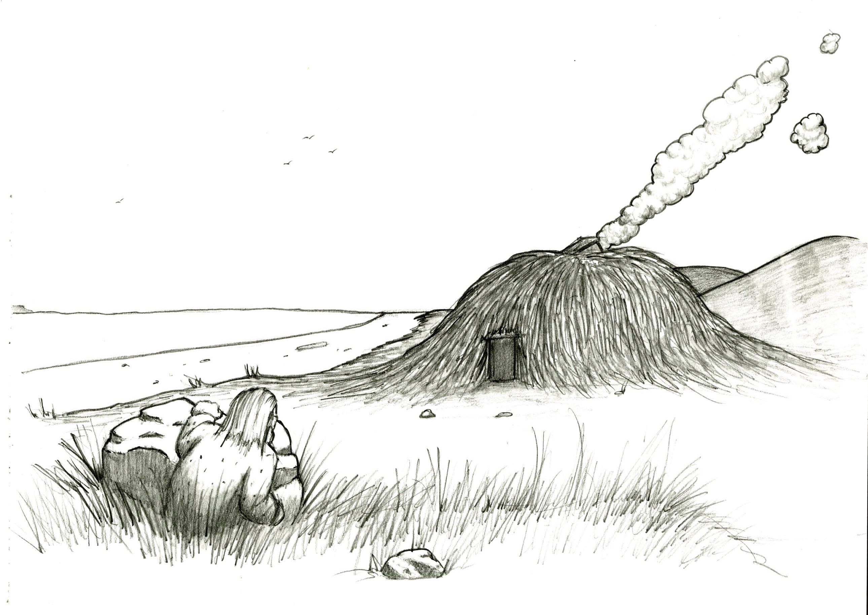
Angutguaq nuyakutar_______ tang’rniqlluku ciqlluaq. Tang’ryugki/(Tang’rsuki) kina ciqlluami et’________. Cuumi tang’rnillki, kesiin ataku tang’rki caqiq iluani.

Slide 8
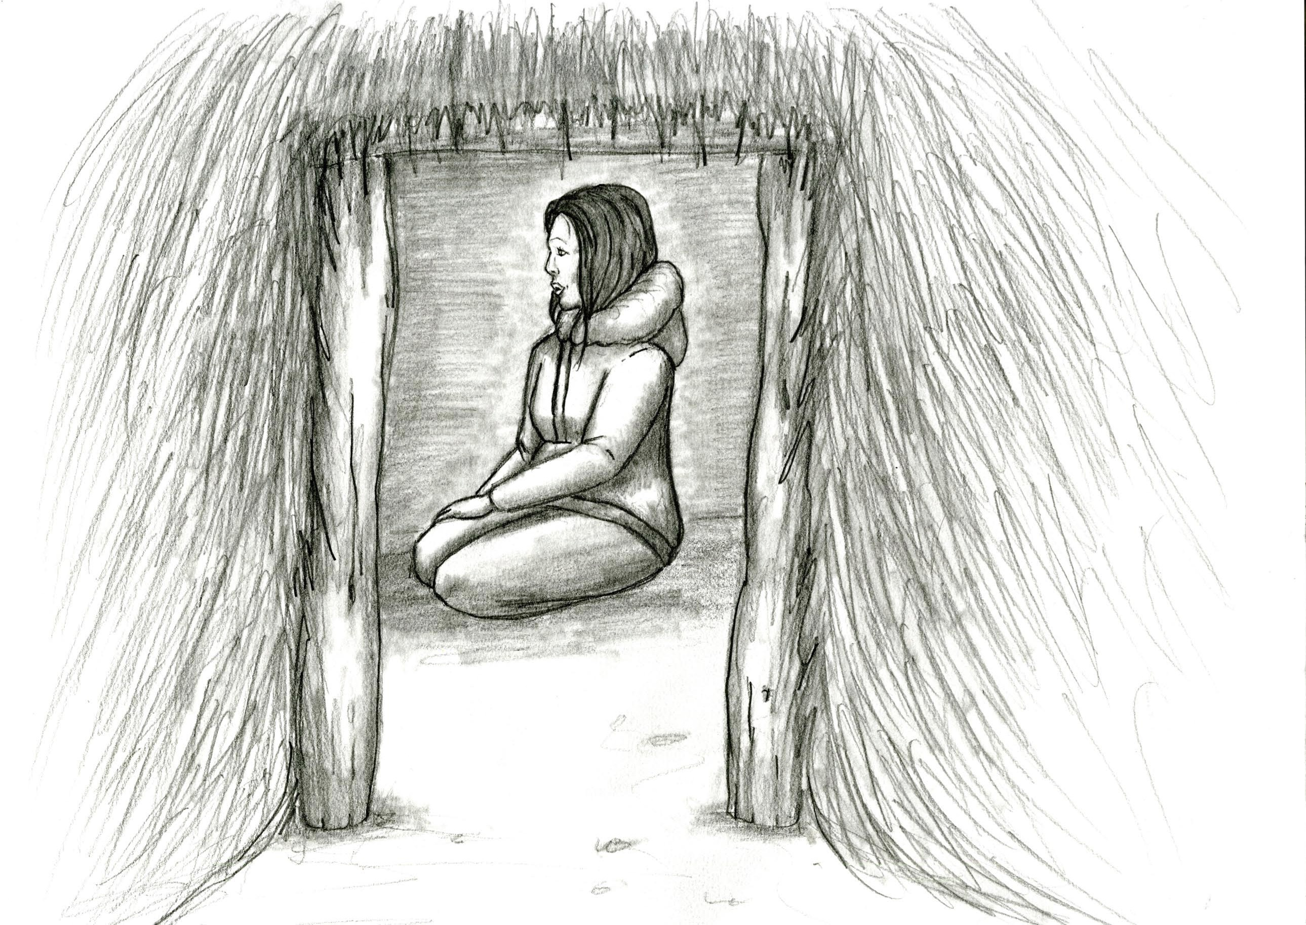
Nuyamaluni, tang’rki arnaq cucunasqaq ciqlluami. Taugum atkua qat’sqanek culunek canama________. Iter________ ciqlluamen, Qateryum amia tang’rluku, teglegluku. Cimikaunilnguq qateryut’stun. Pinakullutek nuliqsauski. Ertii tamiin arnam wiini pikiyutalirluku, keniyulluku.

Slide 9
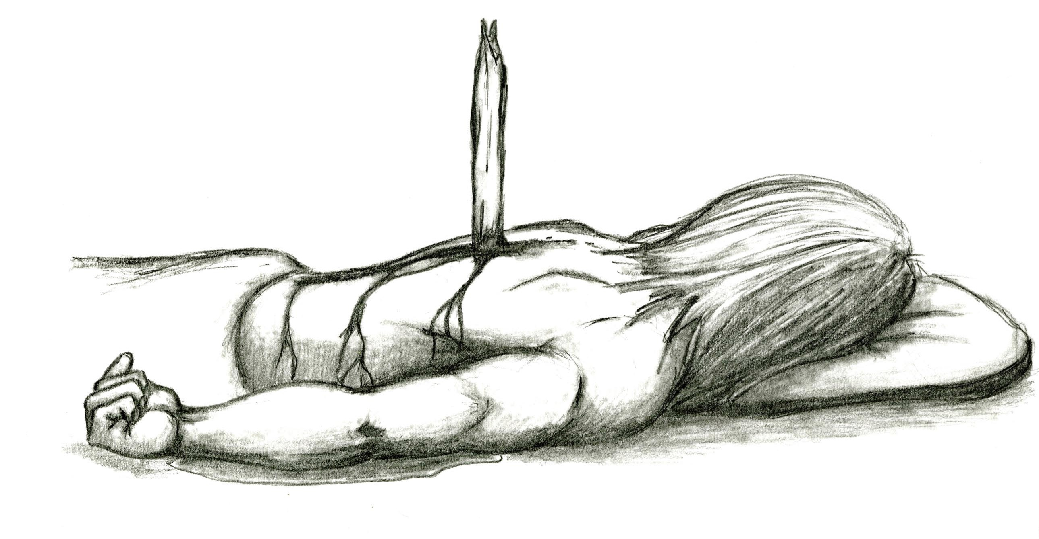
Tang’rnisqaq ciknaqlluku. Unugmi, Angutgauq qawarngami, Tang’rnisqam tuqulluku angutguaq. Taumi-llu Tang’rnisqaq niugluku, “Kasucuwamken” Niugluku, “Maut tai______ kasucaturluten, kesiin angq’rqiarkugnga. Kasutningaitamken!”

Slide 10
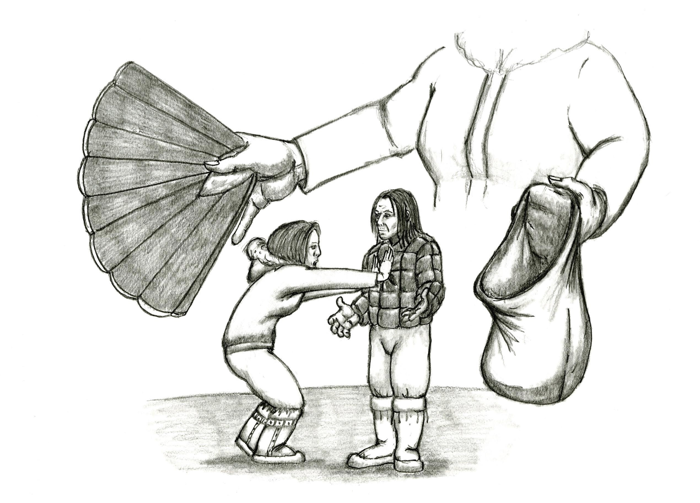
Tuqarluku arnaq, niulluku “Ageningaituten natmen, nuliqsauciqamken”Qateryum cingluku sunarausqaq taumi amia ikuki, angutguam misungcugmi. Niuglluni, “Tawa-ruq! Nuliqsautningaitaarpenga!”

Slide 11
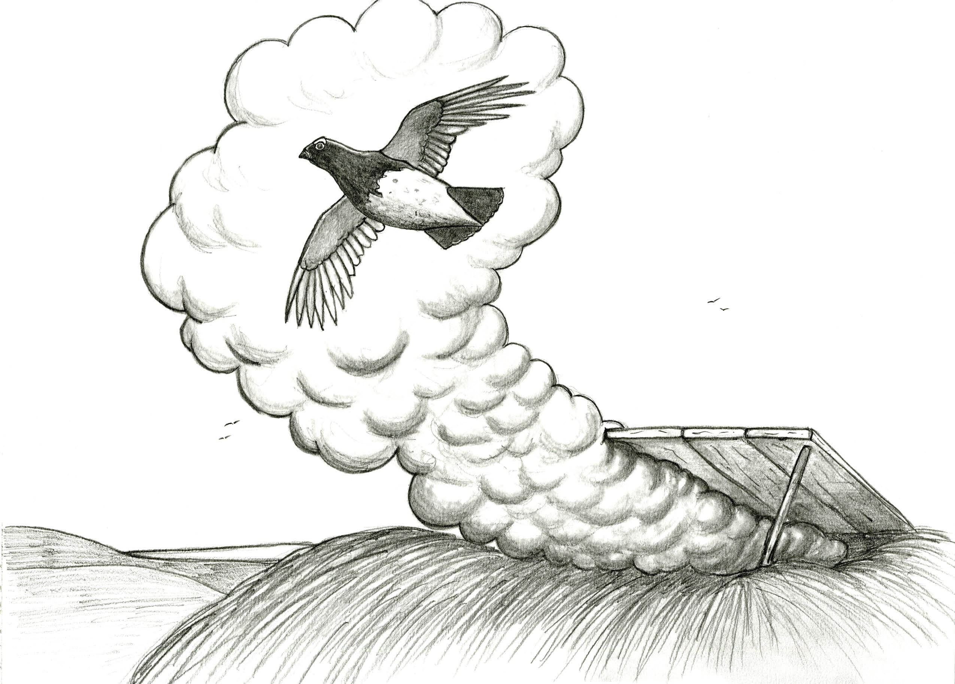
Taumi-llu qateryum amia, ugcuulluku pingayunek, alluku, taumi teng________ anluni. Tang’rnisqaq Nukallpiaq kiimi awa’i. Kinguani nuliituq, angayuinani.

